Slide 1

Making Things Happen
Empowering People, Inspiring Community
Notes:
Thank you very much for the invitation to speak today. My name is Paddy and this is my colleague Aimee and we are from nicssa. Today we are going to provide a short presentation on the benefits of you joining nicssa. If we have time at the end I can answer any questions or alternatively you can get in touch via email.

Slide 2

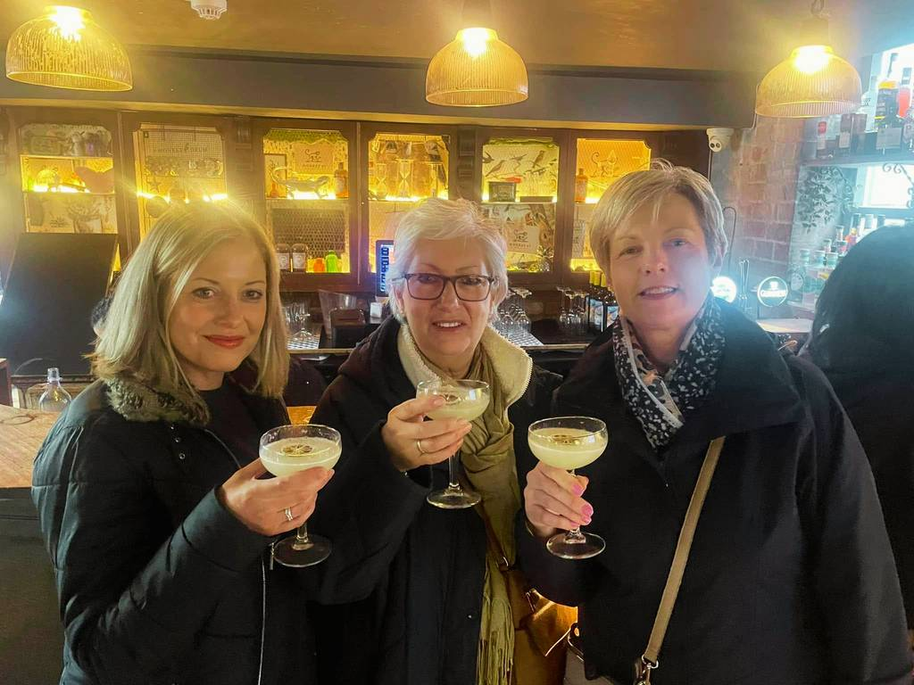
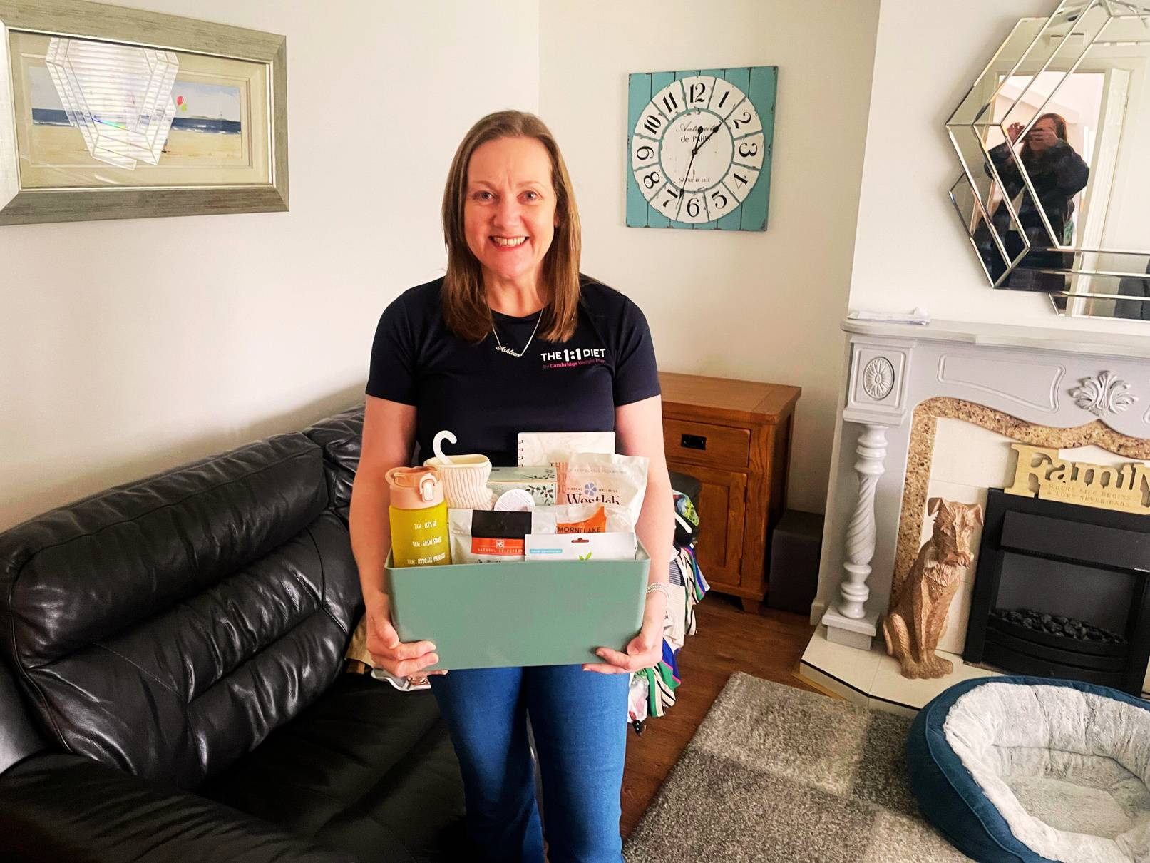
Who we are...
We are a membership based organisation for Civil Servants and their families within Northern Ireland. We have over 7000 members based across the whole of Northern Ireland, with our office based within the Pavilion Complex in Stormont Estate.
What we do...
We improve our members lives by developing and promoting a wide range of health & wellbeing opportunities in the leisure, entertainment, sporting and lifestyle industries.
Notes:
So who are we…humble beginnings to having a footprint right across Northern Ireland
What we do…

Slide 3
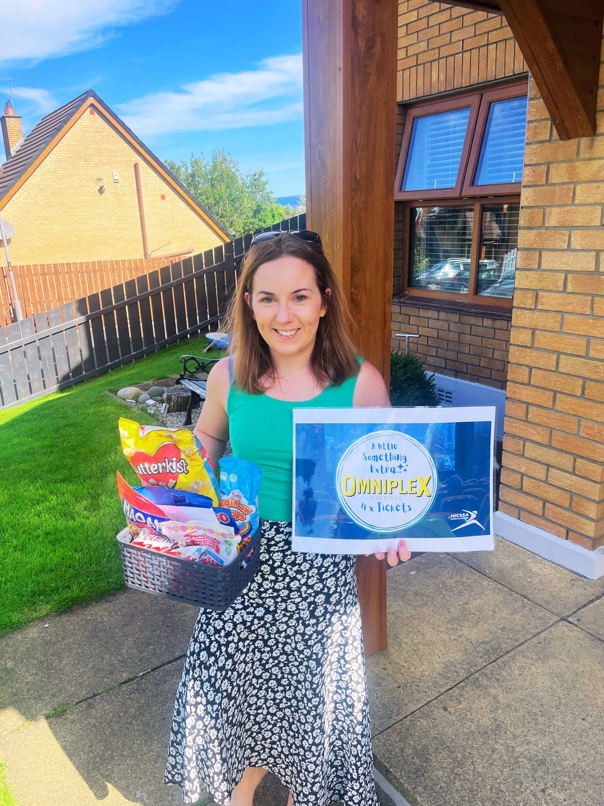
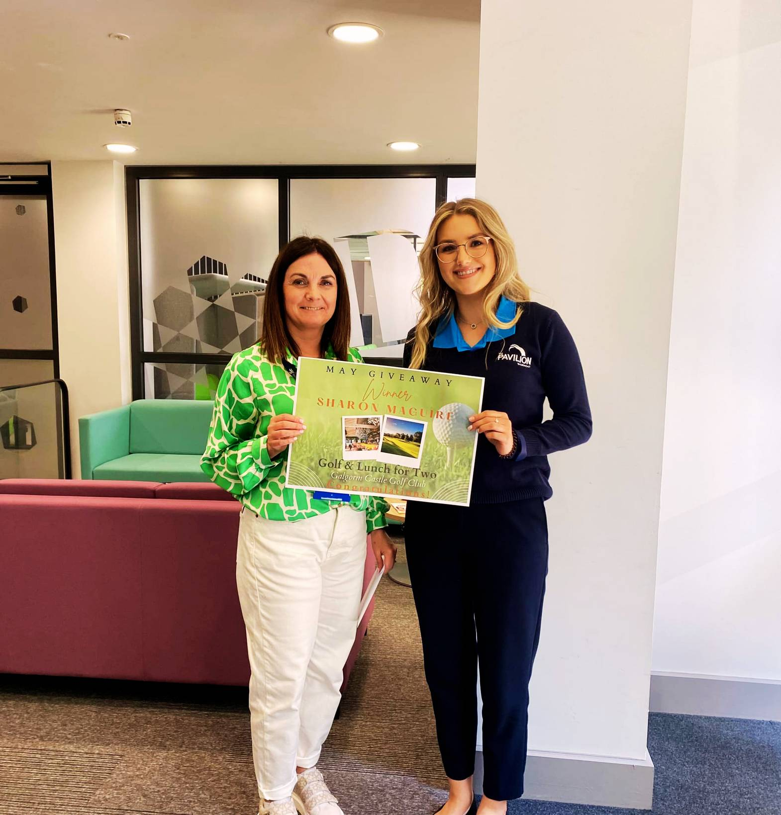
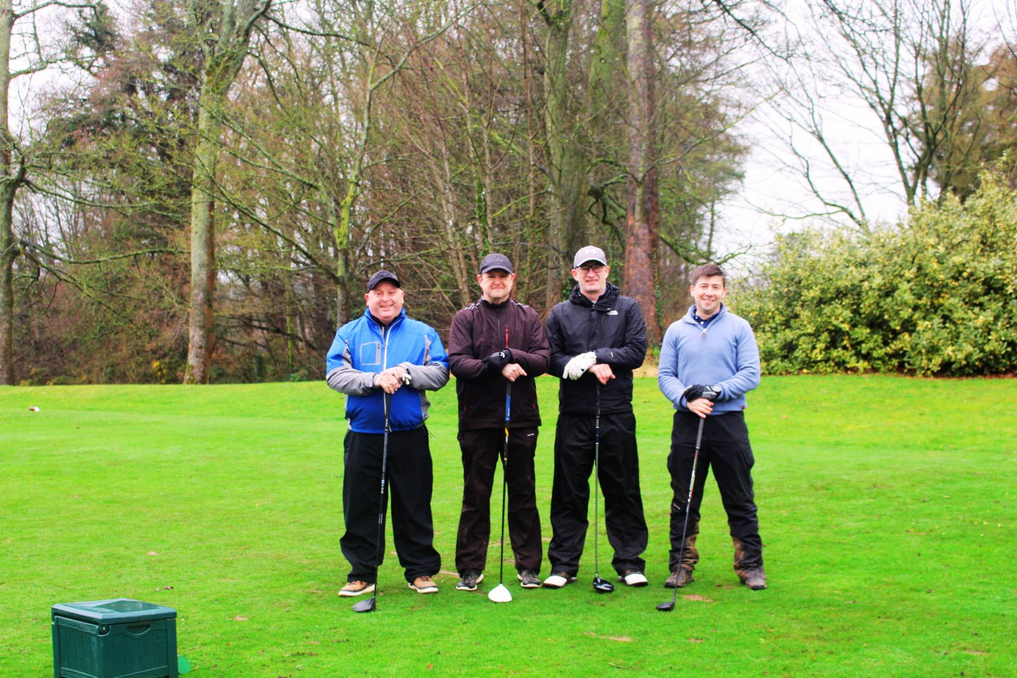


How we do it...
Events
Giveaways
Discounts
Wellbeing
Notes:
Today myself and Aimee will give you a quick insight into the benefits listed above but I would strongly encourage to get in touch or to visit the website to get a fuller understanding of all your potential benefits.

Slide 4
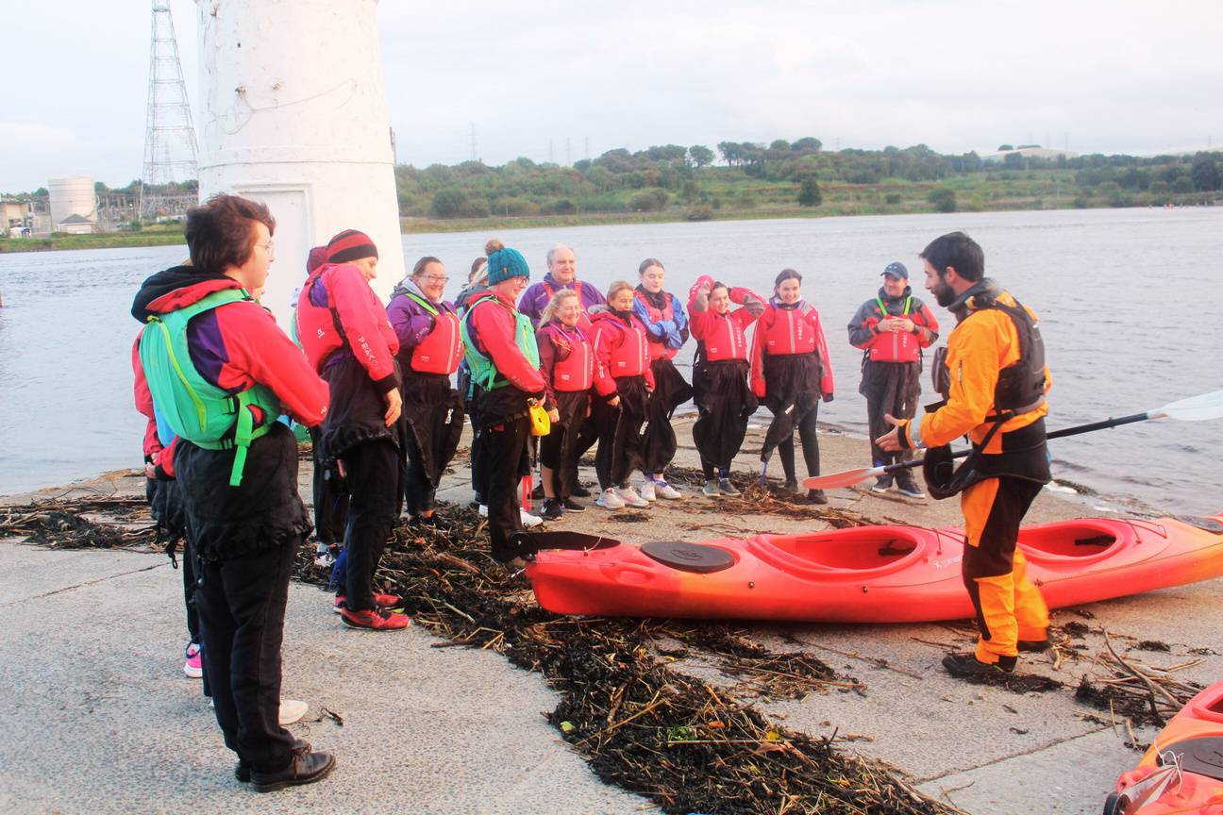
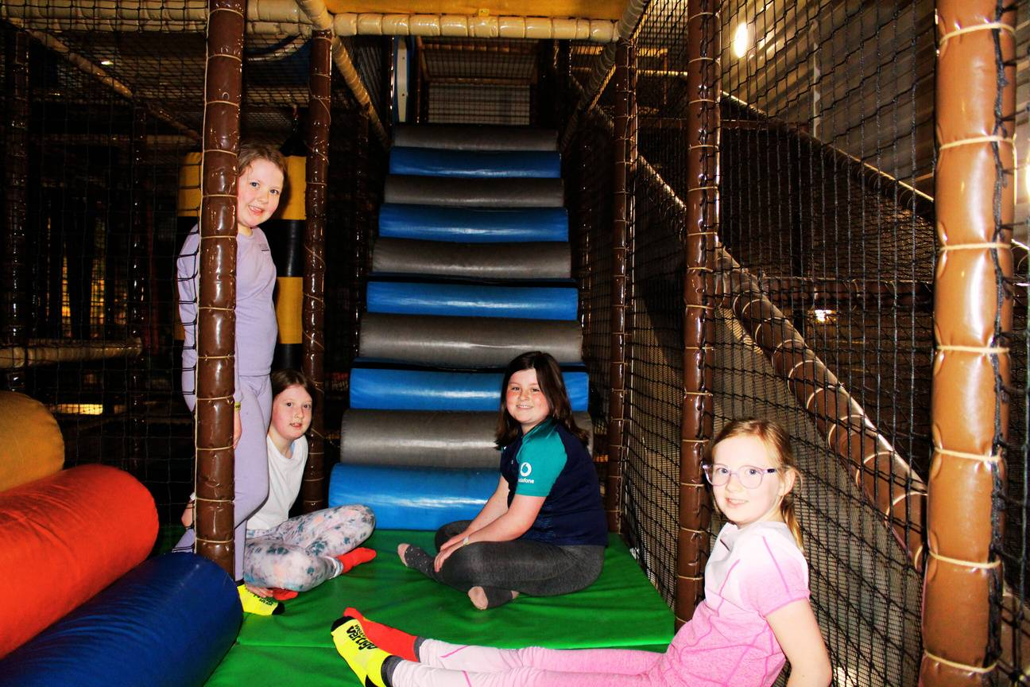
Events
SOMETHING FOR EVERYONE
Family days out, Foodie, Creative, Sports & more
LOCATIONS ACROSS NI
Jungle NI, Castlerock, Omagh, Enniskillen, Montalto, Belfast, Derry/L’Derry
MASSIVE SAVINGS ON RRP
Experience things for less with nicssa with up to 50% rrp
Notes:
Discuss slide…
Aimee is now going to go over the next couple of slides where she will give a better idea of the events we organize and the potential savings involved.

Slide 5
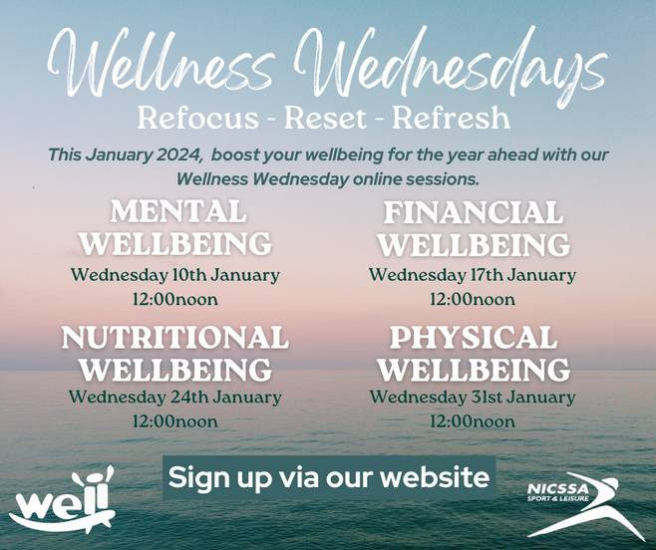


Wellbeing Events

Slide 6




Family Fun Events

Slide 7




Foodie Events

Slide 8



Creative Events

Slide 9




Adventure Events

Slide 10


Upcoming Events

Slide 11


Upcoming Events

Slide 12

Upcoming Events

Slide 13

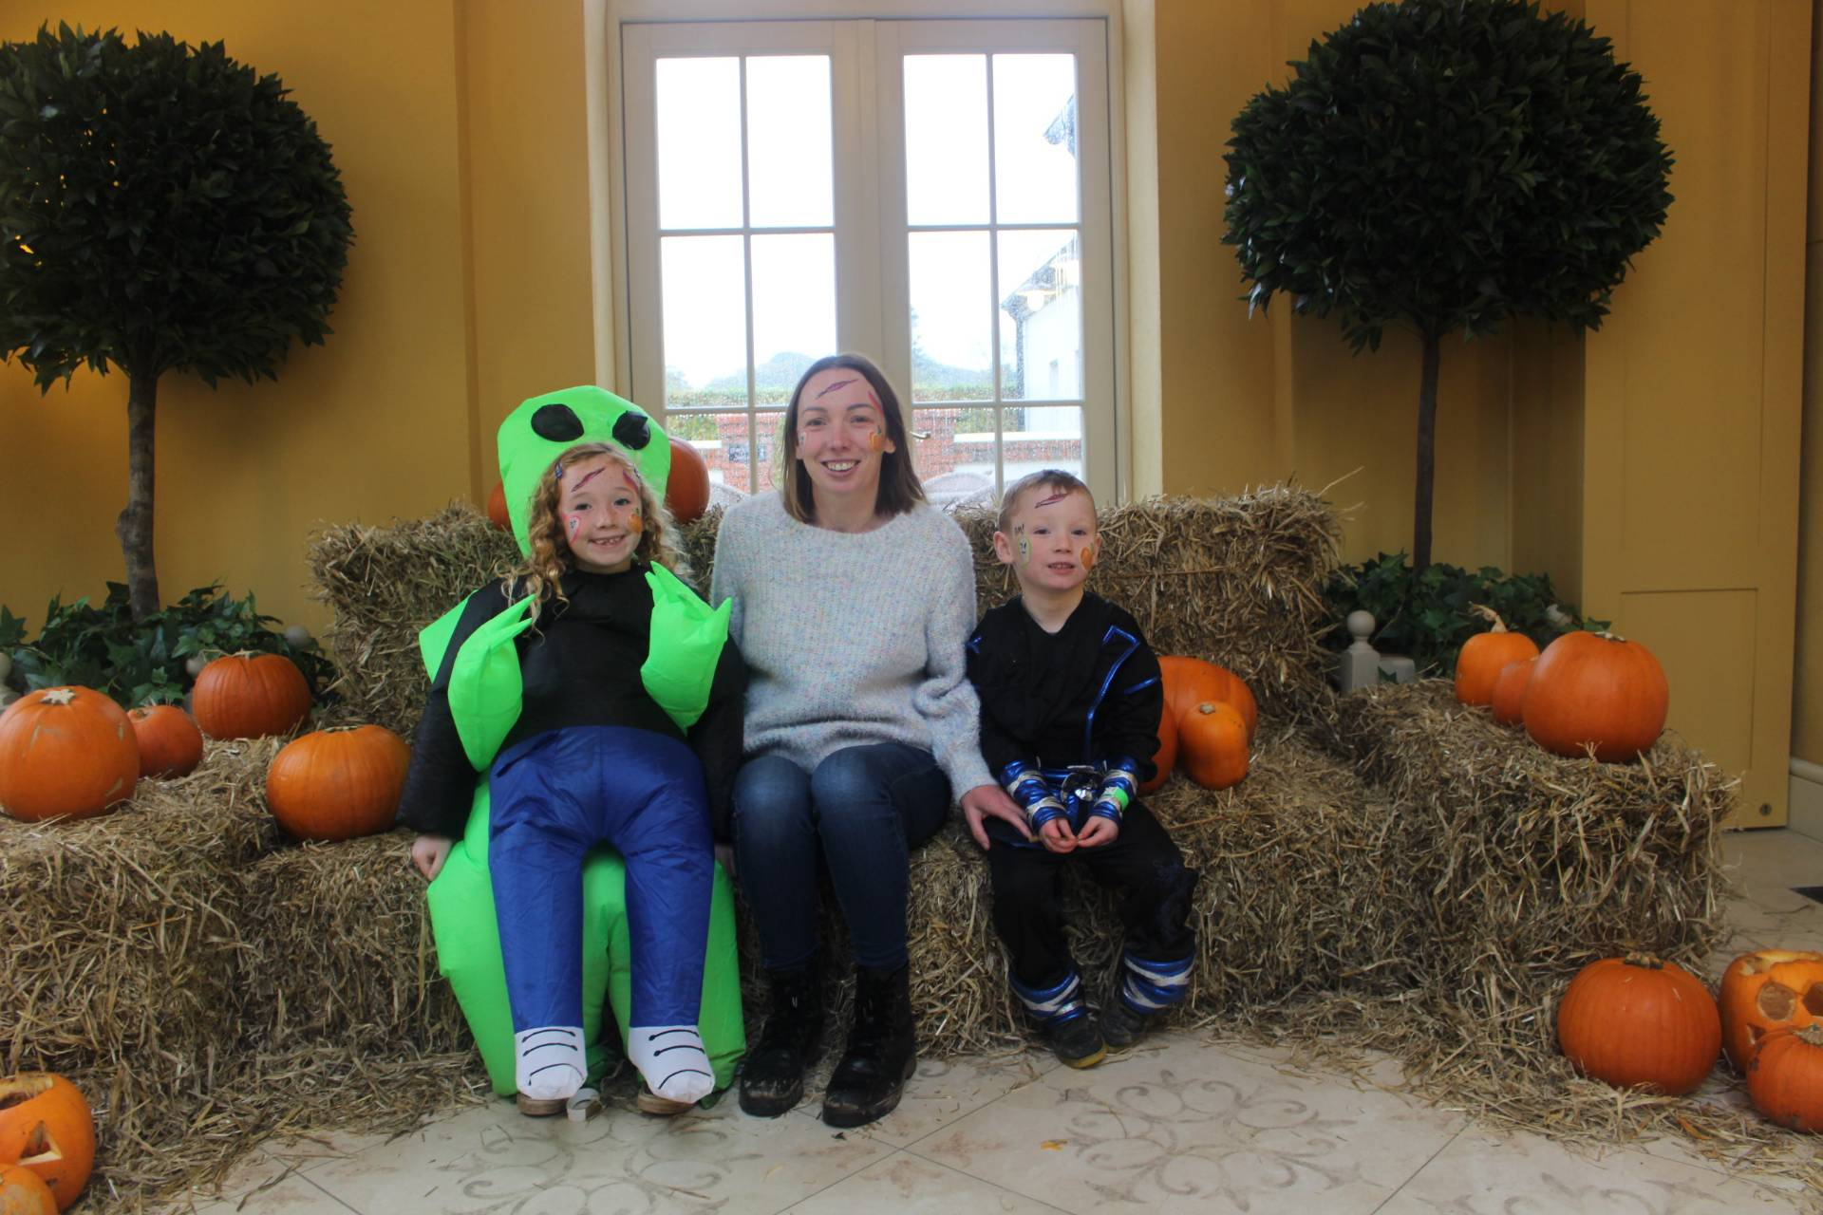

Events have saved me so much money this summer
It’s Great to see events in our area that reflect our interests
This year you have really stepped up your game with events! We have had adult days out as well as family days! Brilliant!
Notes:
Some feedback from members regarding our events. Its extremely important for us to have a wide variety of events, we all know the price of everything has gone up massively so if a member can avail of family days out at an affordable cost to them then we are happy. Our events also take the pressure of you trying to organize, if there are events you would like to avail of you don’t need to worry about the hassle, we look after all of that. Simply book on, save money and enjoy.

Slide 14

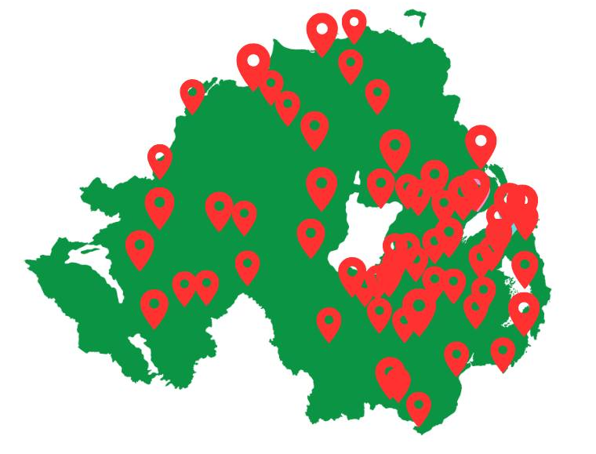










2025 Giveaways
Winners Home Location
Notes:
Our next main benefit is now our monthly giveaways. These giveaways are open to all of our membership, and you simply just need to be a nicssa member and register your interest for your chance to win one of our fantastic monthly prizes. This graphic shows the winners location across 2025 as well as some of the massive brands you can potentially win.

Slide 15
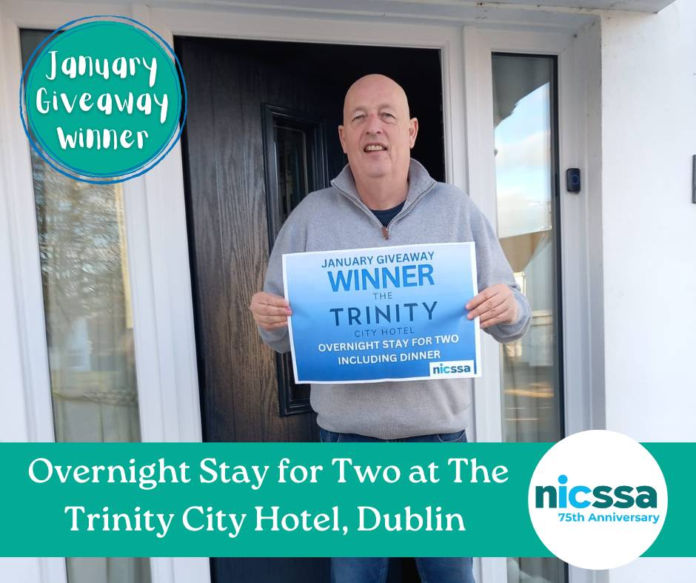
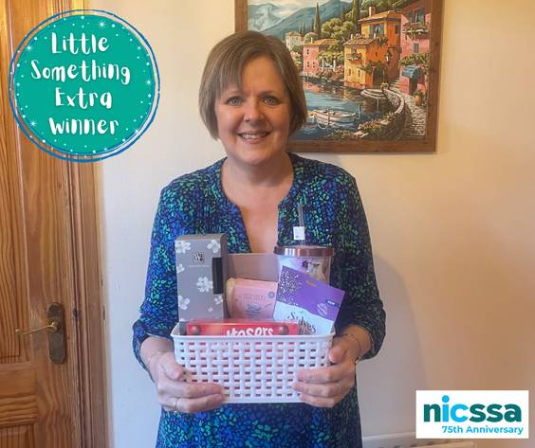
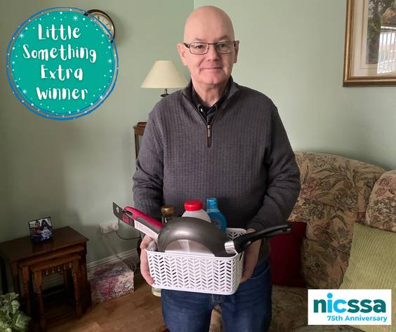
Giveaways 2025
4 x Disney on Ice Tickets
Galgorm Resort and Spa Overnight Stay for 2
Ninja BBQ
Family Pass Emerald Park & Cadbury Hamper
Glamping Stay
Coffee Machine
£500 Hays Travel Voucher
Overnight Stay in Dublin
3 Wellbeing Hampers
2 Pancake Day Hampers
12 Random Acts of Kindness
12 Easter Hampers
£500 The Range Voucher
Family Pass Emerald Park & Cadbury Hamper
6 Summer Hampers
Notes:
Here again is some more detail on our 2025 prizes. We always mix it up with our giveaways and try to ensure there is something for everyone across the year.

Slide 16






Slide 17


Slide 18
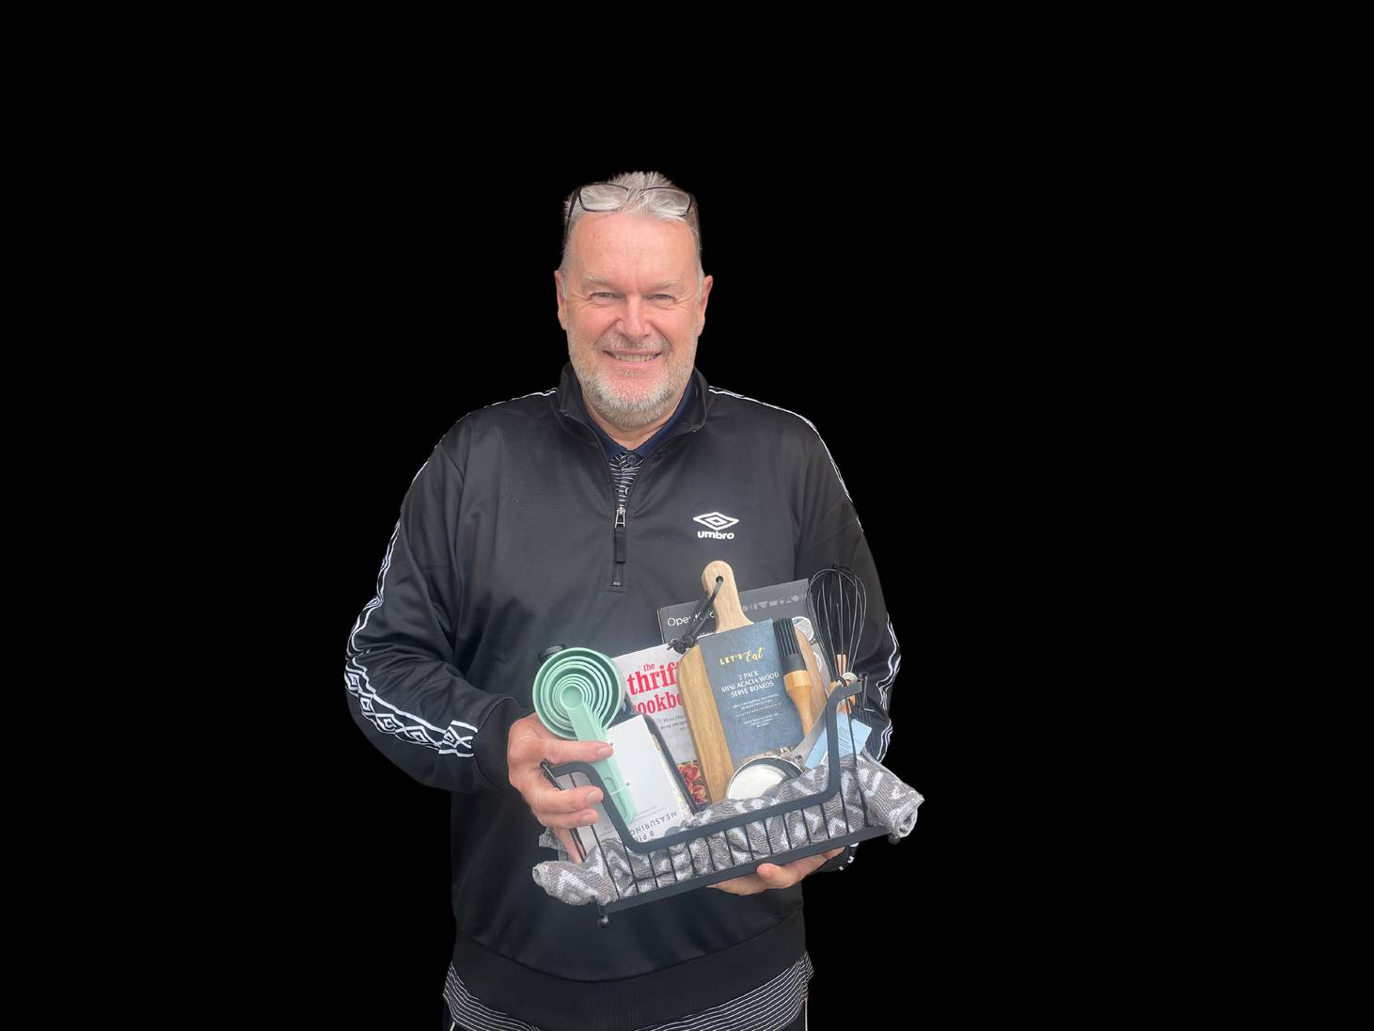

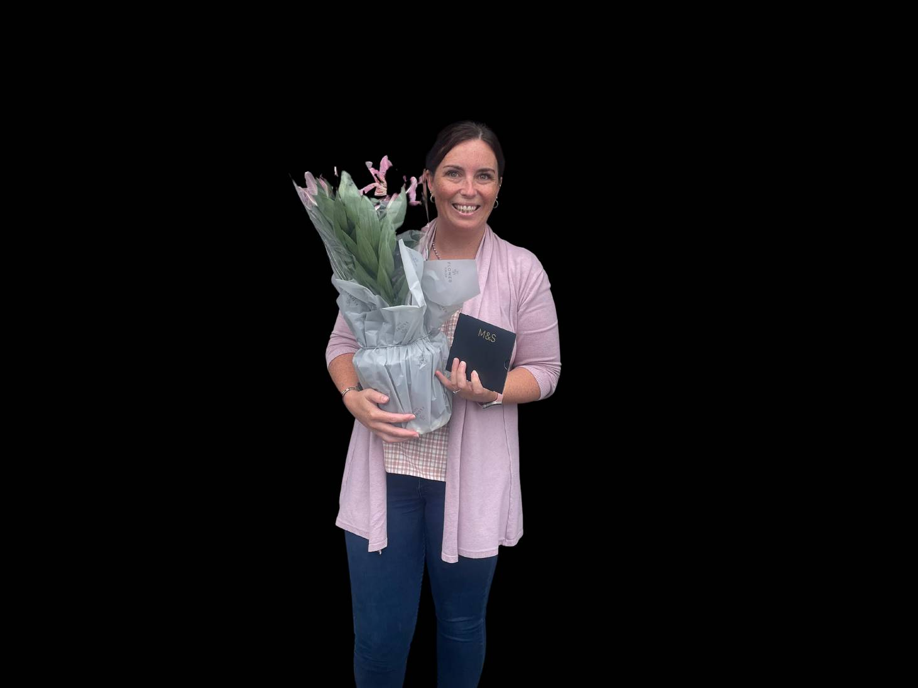
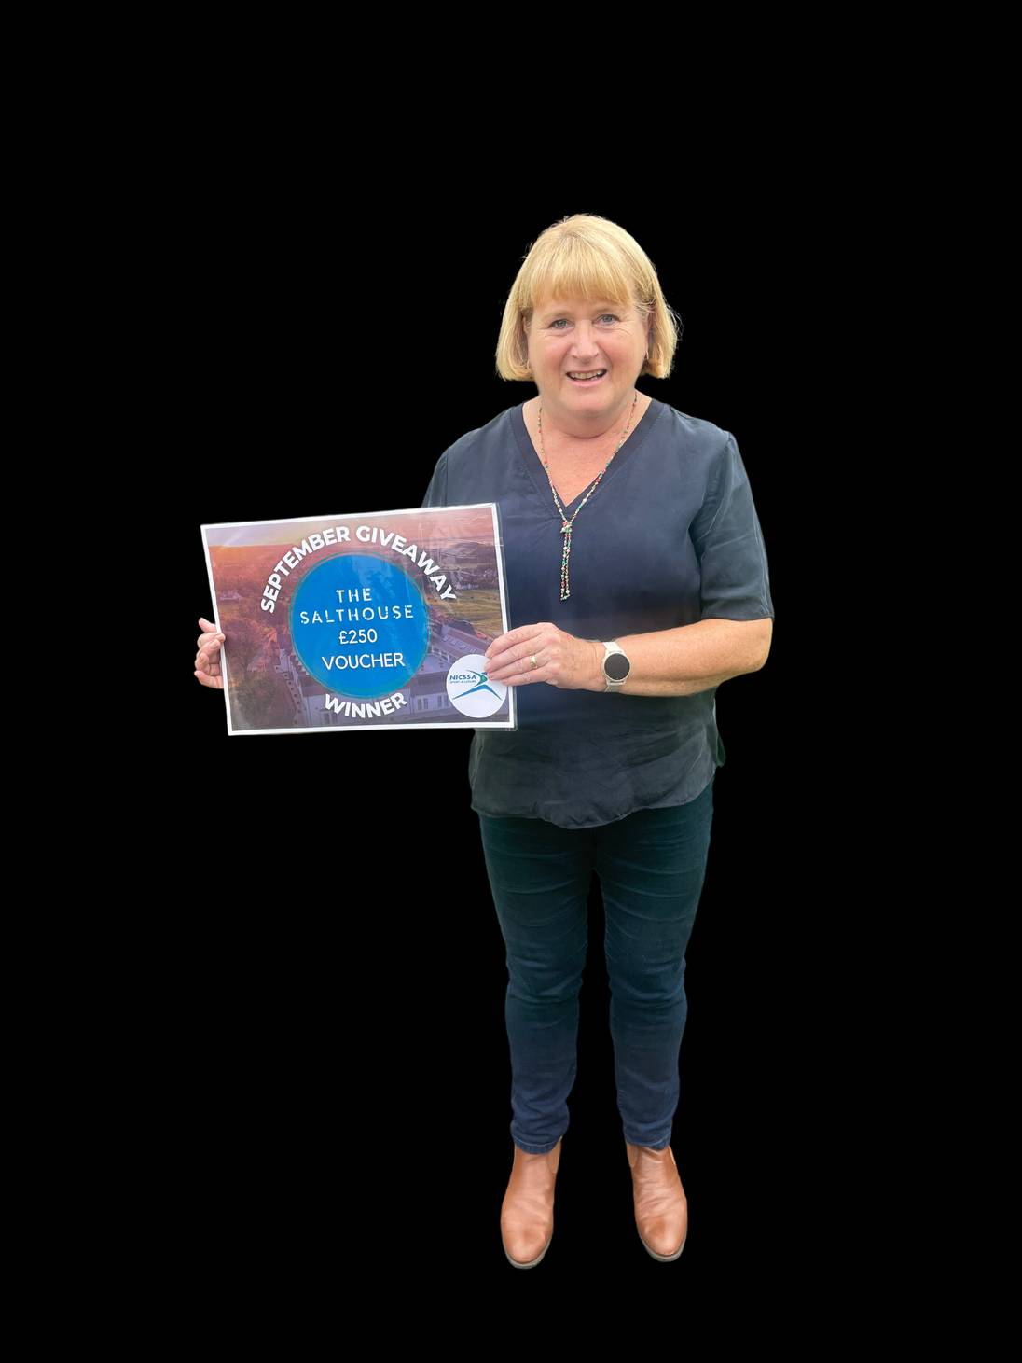
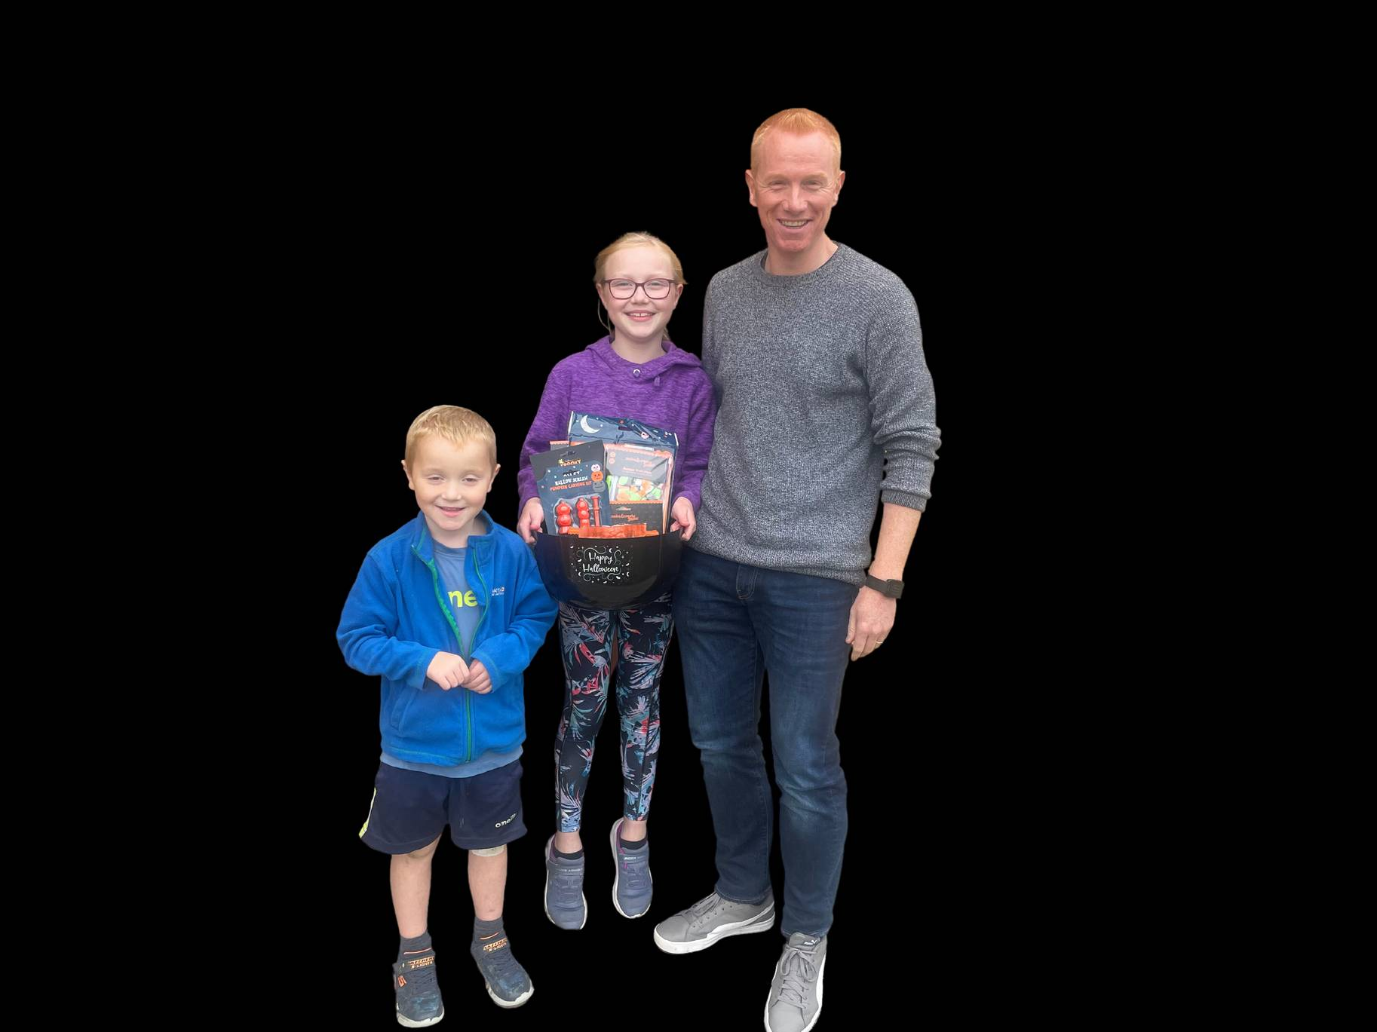
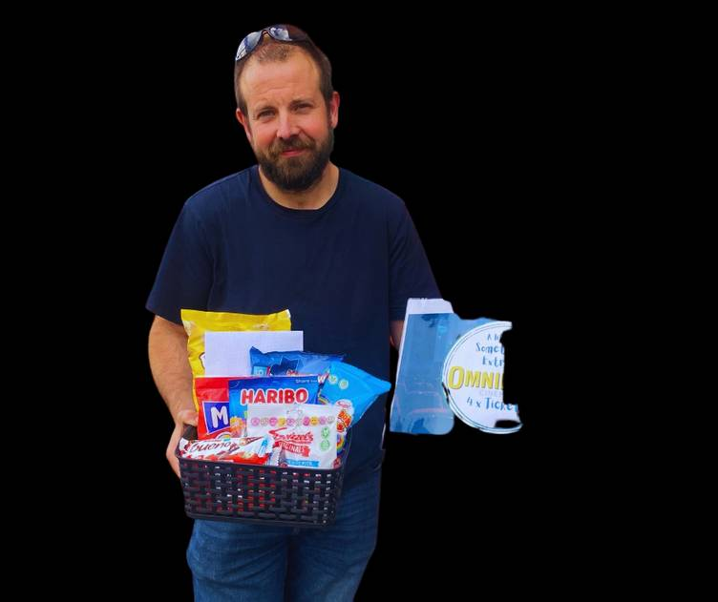
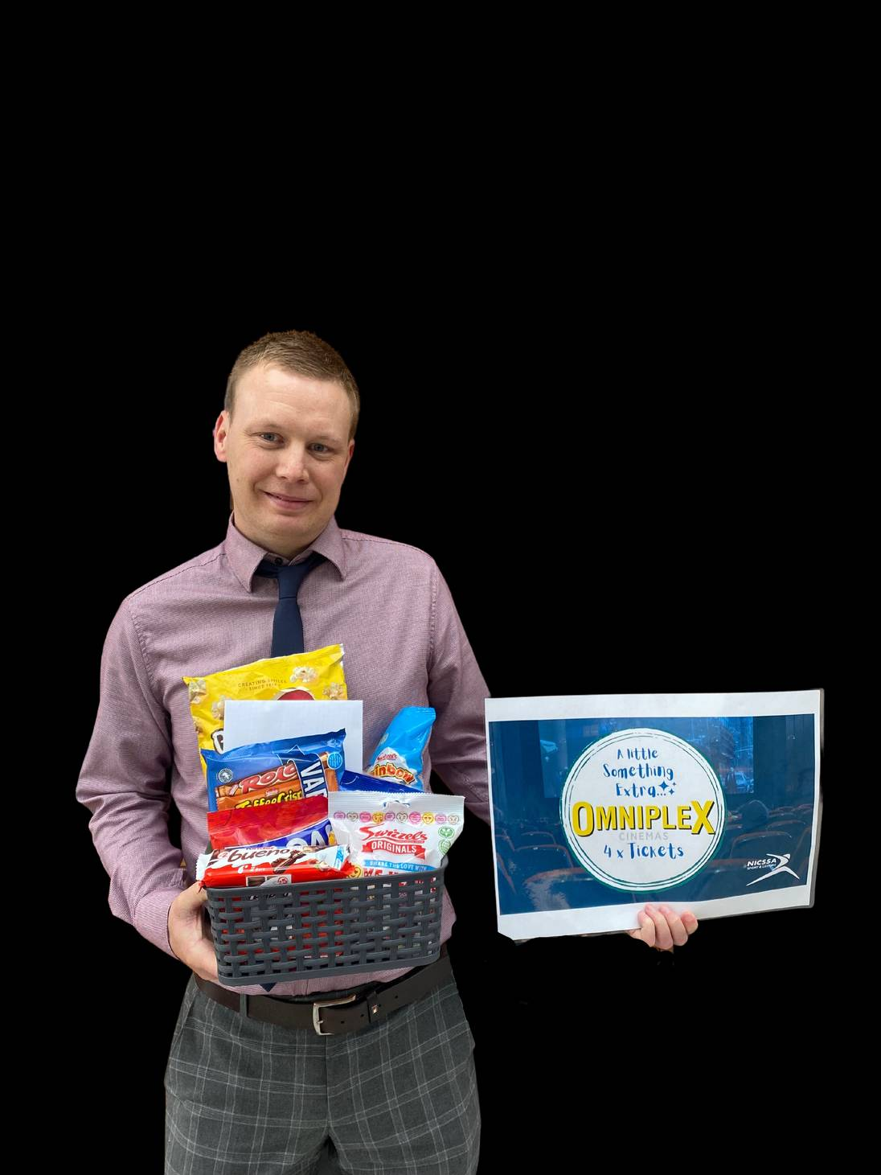
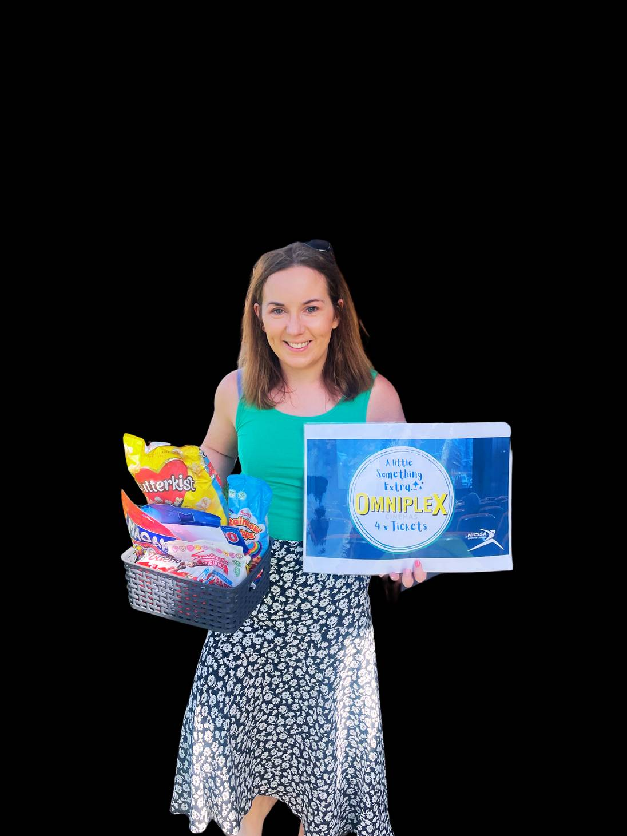
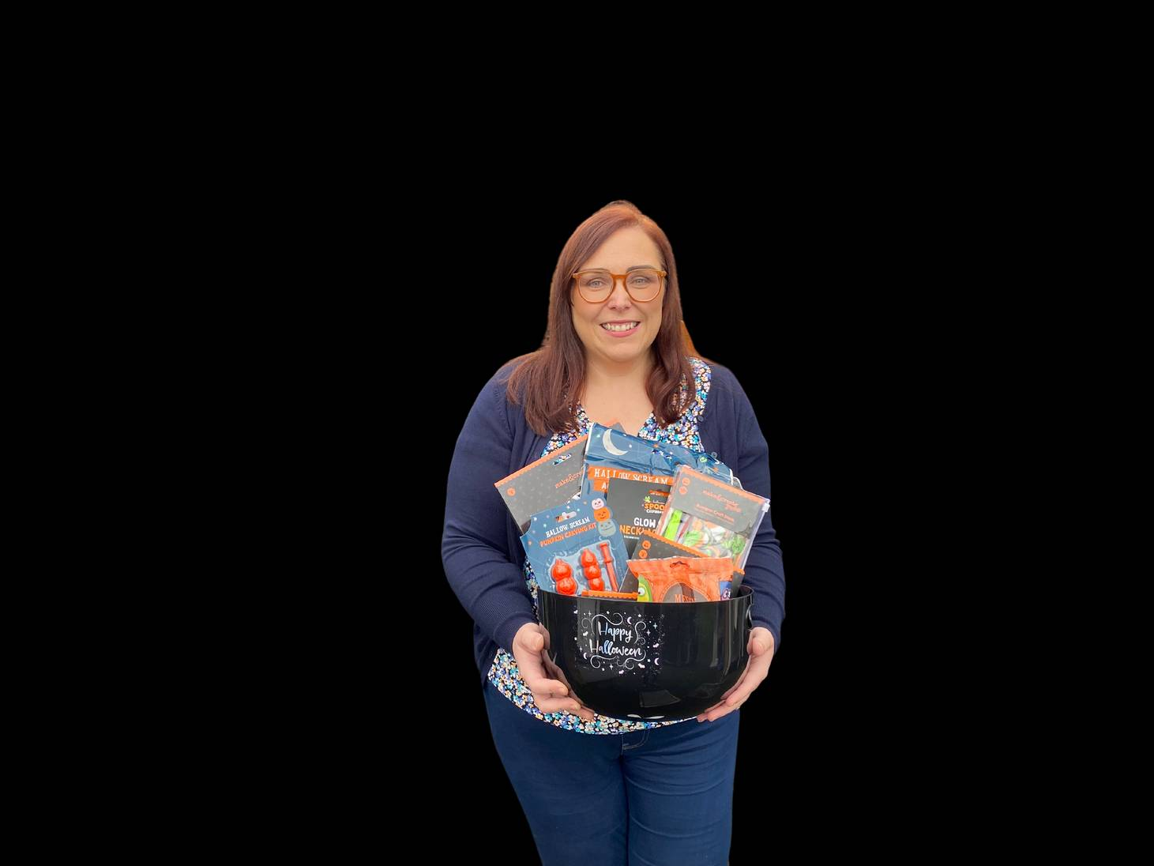

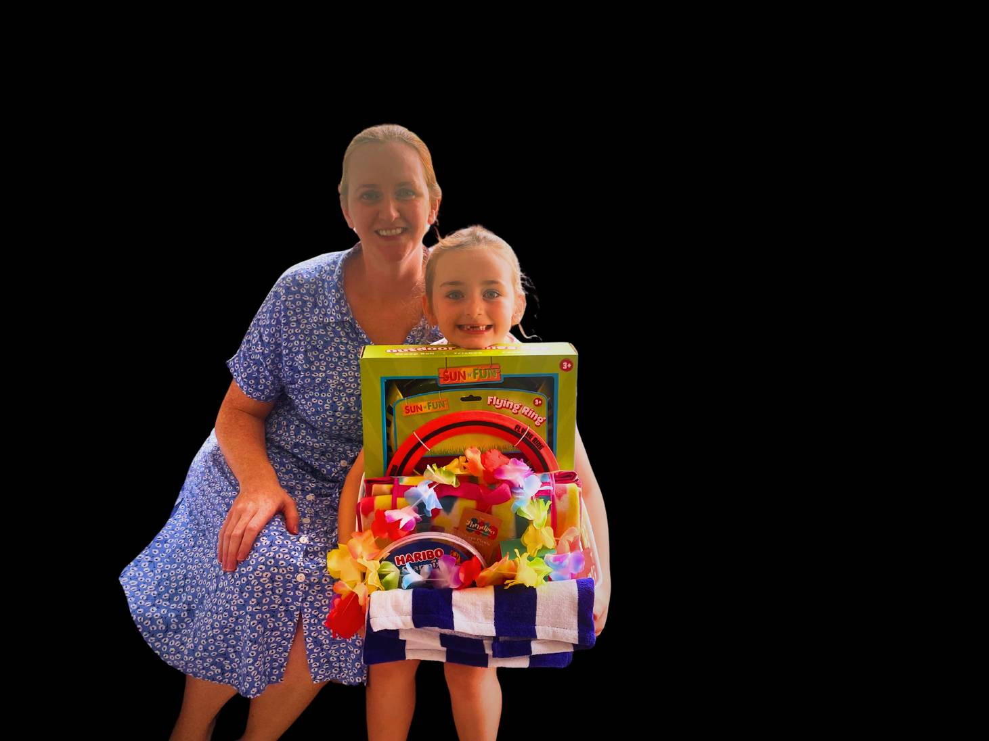
Giveaways are such a Great Benefit of NICSSA Membership
I am so delighted with my prize! Thank you NICSSA
My Giveaway Prize was such a surprise and was a hit with the kids! Thanks
Notes:
Some of our winners giving feedback. We really do try to put our money back into our membership. The more members we have the more events we can put on and the cheaper make them be or we can increase our give away prizes or add in more prizes so you have a better chance of winning.

Slide 19


Exclusive Discounts...

Slide 20


Exclusive Discounts...

Slide 21

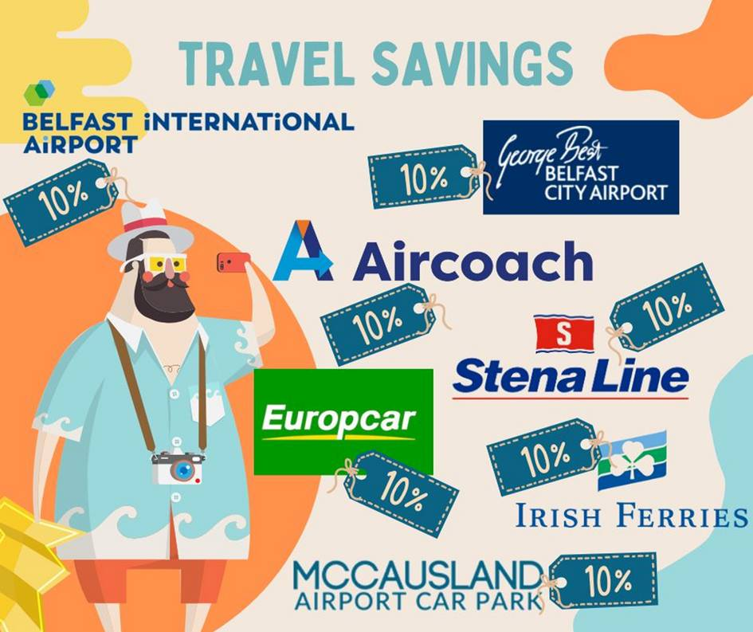
nicssa Discounts...

Slide 22


nicssa Discounts...

Slide 23
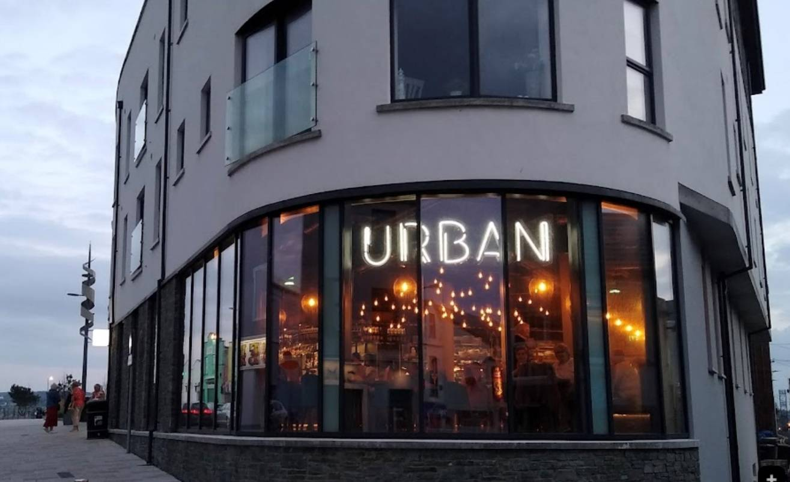


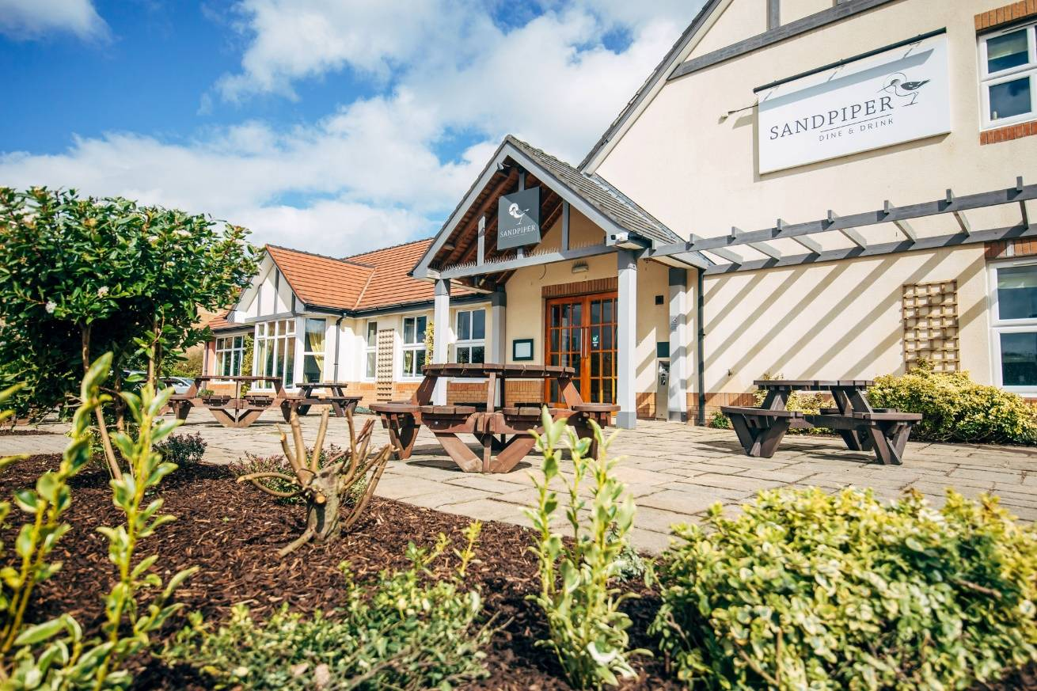
nicssa Discounts...
10% Off
10% Off
10% Off
15% Off

Slide 24
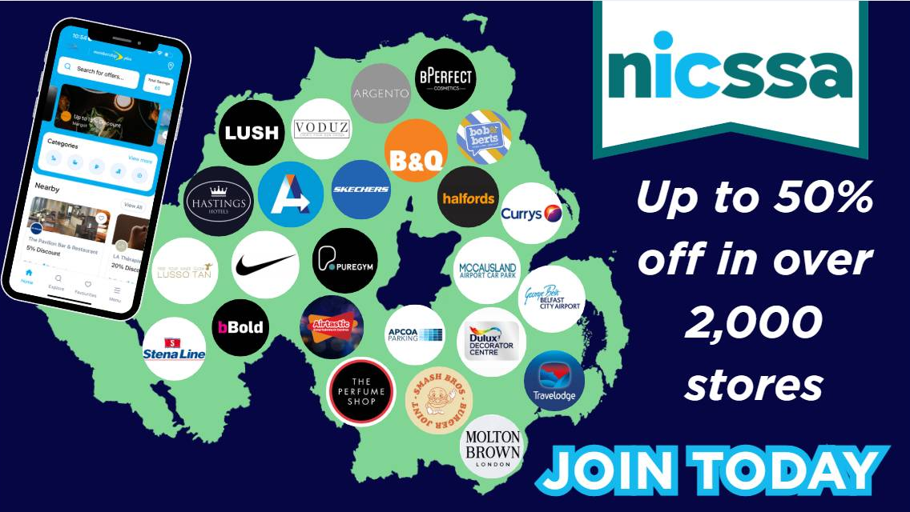

Slide 25

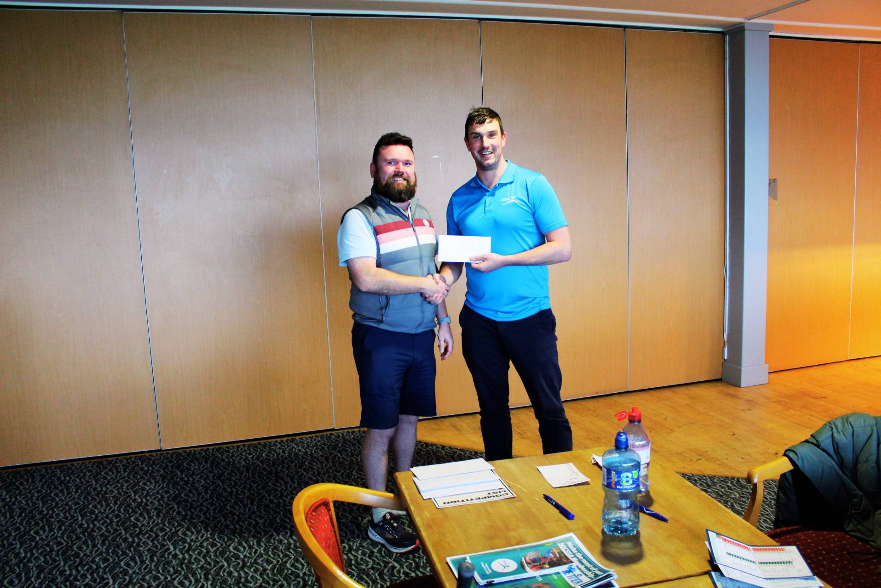

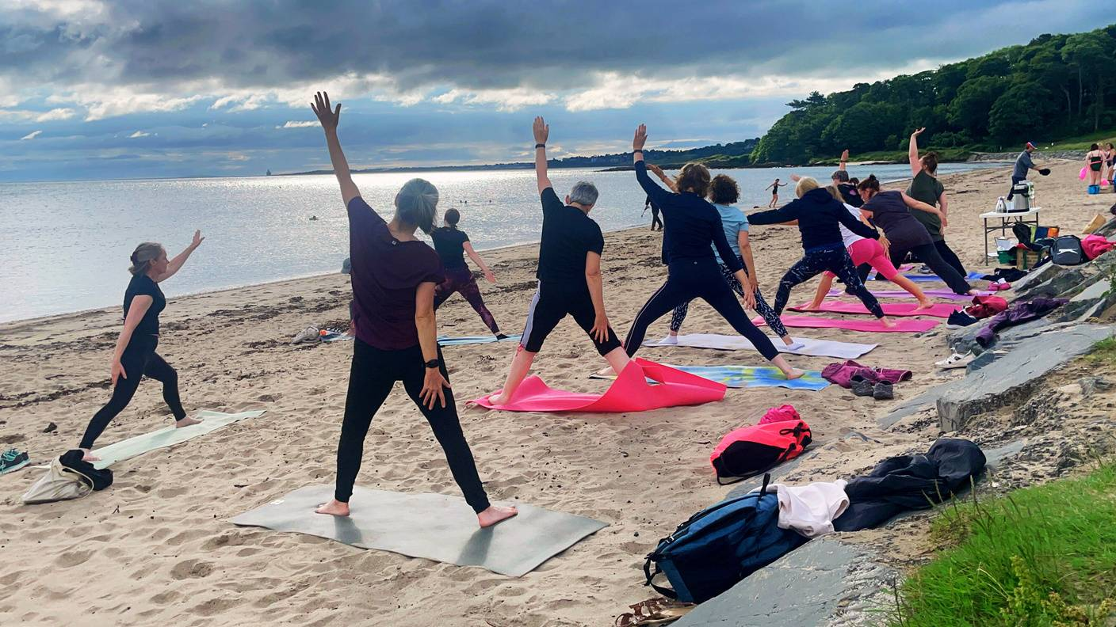

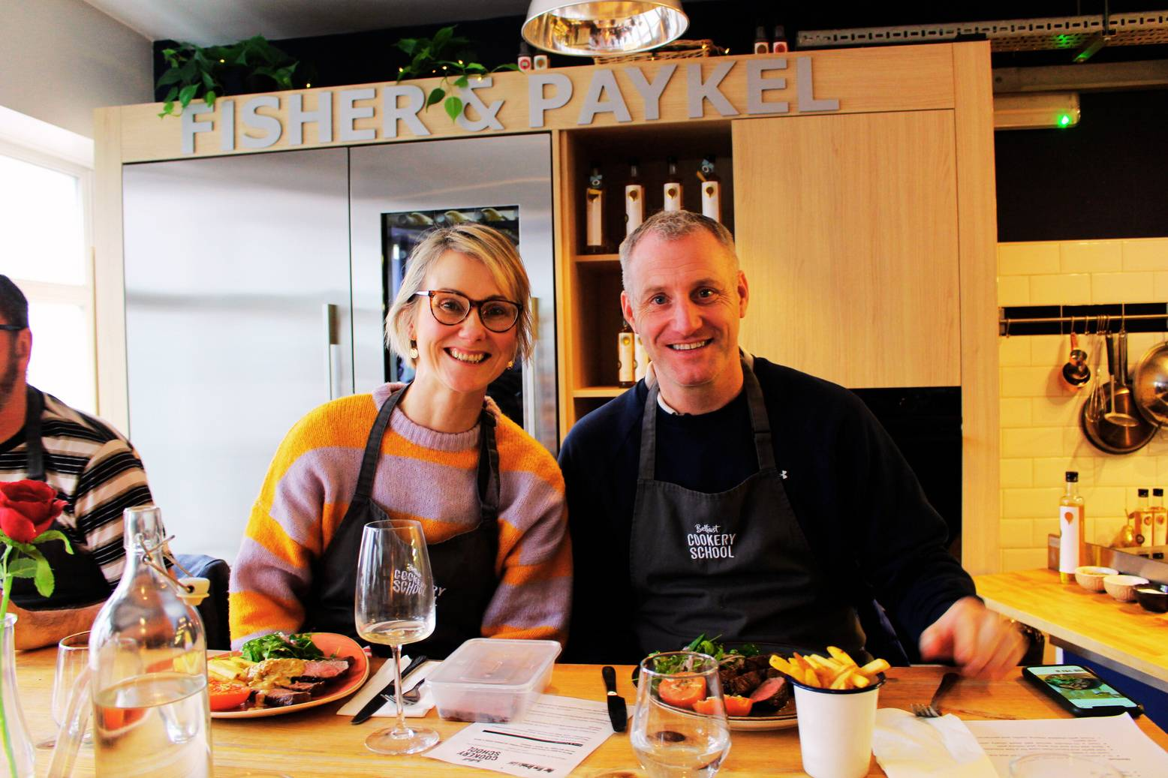
NICSSA Membership
£6.89 per month
Pay via Payroll or Direct Debit
Email
info@nicssa.co.uk
Notes:
So our membership is £6.89 per month and you can pay via Payroll or direct debit. By signing up to nicssa you will automatically be affiliated to the nicssa based club here within the Police Ombudsman which is ran by the guys on site. The club is organized and ran by these volunteers to help provide you with benefits and activities directly through your workplace. Nicssa support this by providing £26 per year to the club for each member they have, so more members your club has the more money the club has to work with and the more they can provide to you.
Lastly for all new potential members and existing members please remember to sign up to giftaid. It does not cost you anything but allows us to claim money back from the government from the monthly deductions you make. This money goes straight back into our membership in the form of events and giveaways so please please sign up if you haven't done so already. www.nicssa.co.uk
If you do wish to sign up please just drop us an email at info@nicssa.co.uk and we can get you an application form sent out.

Slide 26
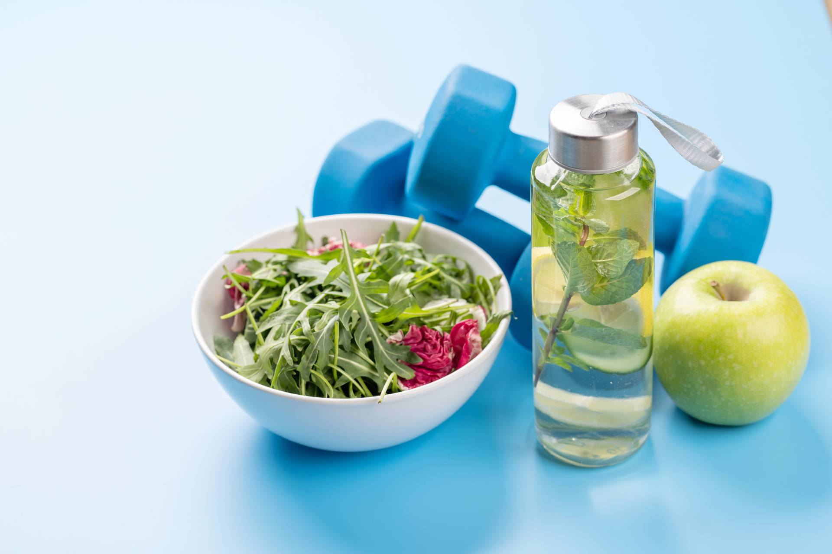

INVEST IN YOUR HEALTH FROM THE INSIDE OUT
Using our advanced technology, it is now possible to take a deeper look into your physical health not just in the hopes of improving performance but also your health and wellbeing.
Services available:
  Vitality Health Check
  Body Composition
  V02 Max
  Premium Food Intolerance
  Resting Metabolic Rate
  Full Cholesterol and Blood Sugar Test
  Sports Performance Testing
Discounts for nicssa Members
Notes:
As well as all that then we also have our nicssa wellbeing. This is to do with all things health and wellbeing and we offer testing for a number of different areas so we have :
Health Checks
Body Composition
Vo2 Max
Food Intolerance Testing
You do not need to be a nicssa member to access the services provided however there is discount for nicssa members.

Slide 27


Slide 28


Slide 29


Slide 30
Contact nicssa
T: 028 9052 0404 | E: info@nicssa.co.uk W: nicssa.co.uk

